Slide 1
Fit track-health&fitness data Analysis

Slide 2
Abstract :-
In recent years, the importance of sleep in maintaining overall health and well-being has gained increasing recognition in the scientific and medical communities. Poor sleep has been linked to numerous chronic health conditions including obesity, diabetes, cardiovascular diseases, and mental health disorders.
In this project, we conduct an exploratory data analysis (EDA) on a dataset titled "Sleep_health.csv", which contains various attributes related to individual health metrics and demographic information that could potentially impact sleep health.The dataset includes variables such as age, gender, occupation, Body Mass Index (BMI), daily physical activity level, and alcohol consumption, among others. The goal of the analysis is to gain insights into the patterns, trends, and potential anomalies in the dataset that may correlate with sleep behavior and health.
The study starts with basic data loading and inspection, followed by preprocessing steps including the removal of the 'Sleep Disorder' column, handling of missing and duplicate data, and understanding categorical variable distributions.Advanced visualization techniques using libraries such as Seaborn and Matplotlib are employed to explore the distribution of numeric features and identify the presence of outliers. Furthermore, correlation analysis among numerical variables is conducted to detect potential relationships, especially among variables that may collectively influence sleep quality or duration.

Slide 3
Outcomes:-
“Performed exploratory data analysis (EDA) on a health dataset to explore factors affectting sleep, including age, physical activity, and BMI.”
Loaded dataset using pandasUsed .head(), .info(), and .describe() to explore dataIdentified data types and basic statistics
Dropped irrelevant column: 'Sleep Disorder'Checked for and found no missing or duplicate valuesExplored and counted unique values in categorical features
Histograms showed most people sleep between 6–8 hoursBoxplots identified outliers in BMI and physical activityAge distribution skewed toward younger adults

Slide 4
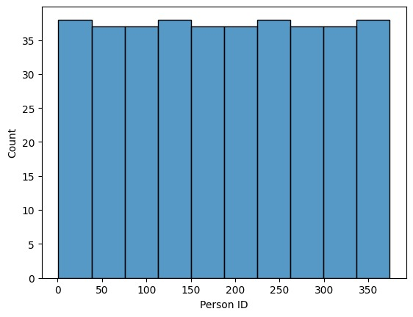
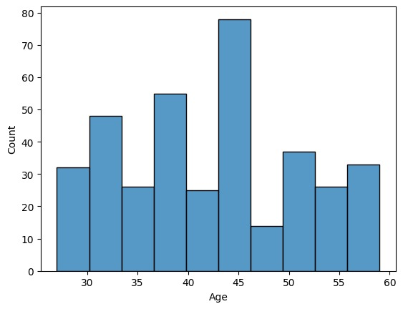
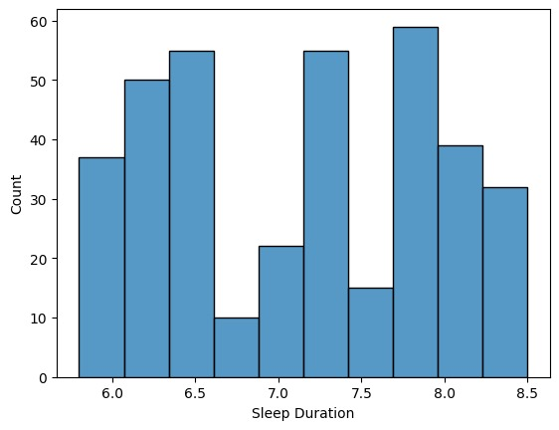
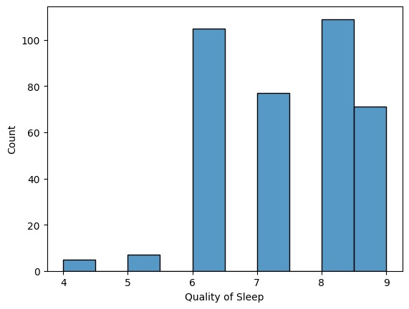
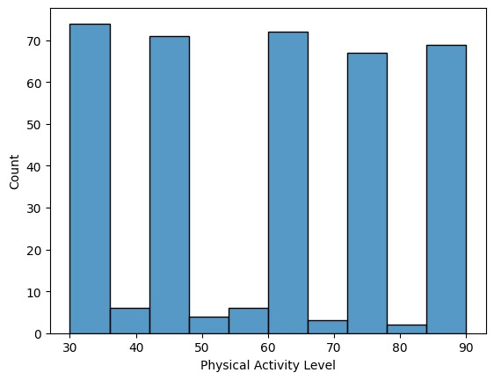
hist plot

Slide 5
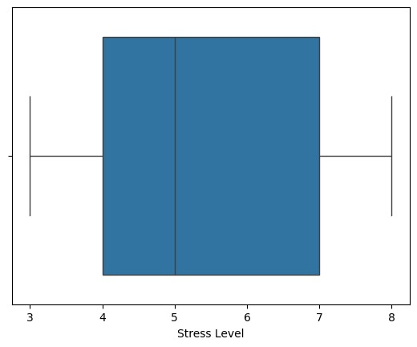
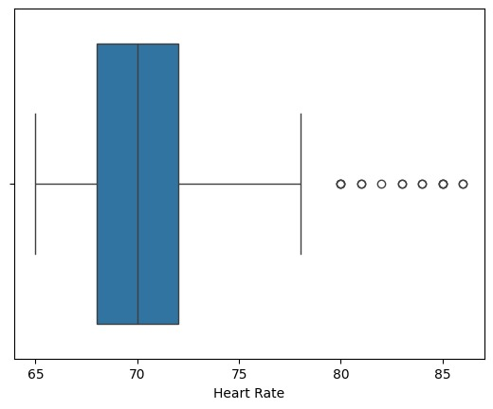
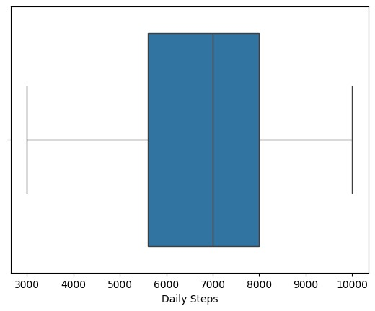
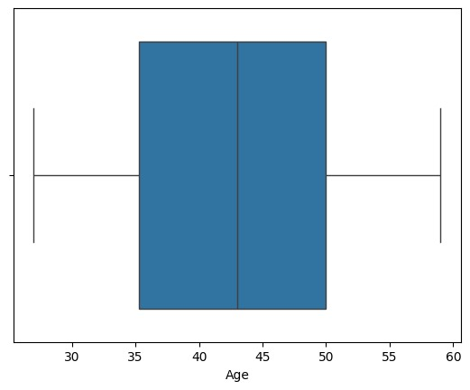
box plot

Slide 6
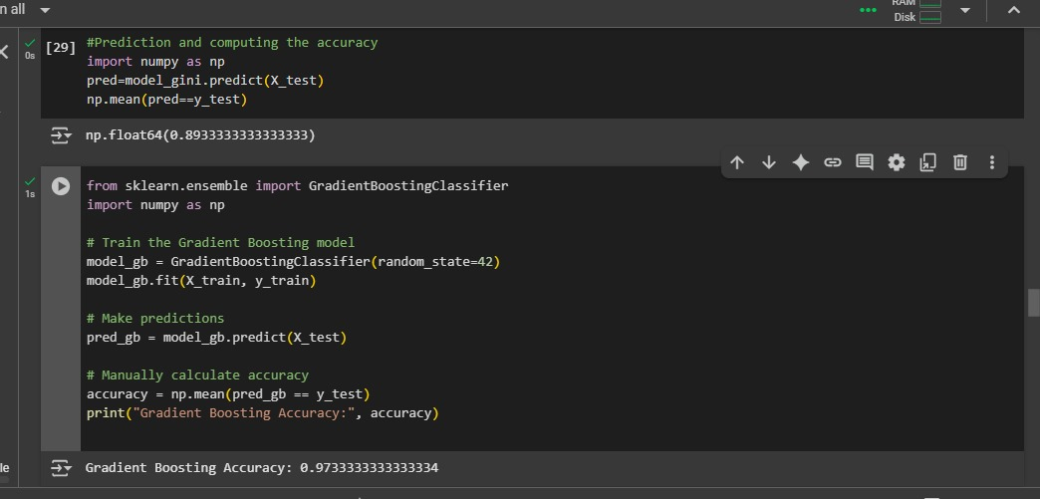

Slide 7
Advantages:-
Comprehensive EDA: The notebook includes a wide range of EDA techniques such as statistical summaries, histograms, and correlation matrices.
Visualization: Use of seaborn and matplotlib aids in understanding data distribution and detecting outliers.Structured
Cleaning: Checks for missing and duplicated data ensure data integrity.

Slide 8
Disadvantages:-
No Modeling or Prediction: The notebook focuses only on EDA and doesn’t move towards building a predictive model
.Limited Insight on Target: The "Sleep Disorder" column was dropped early on, removing the possibility to explore supervised learning or target-specific analysis.
No Conclusions Drawn from Visuals: The results of visualizations are not interpreted in markdown cells, which reduces the explanatory value

Slide 9
Conclusion:-
The analysis provides a solid foundation in understanding the structure and distribution of health-related data, especially factors associated with sleep. However, it lacks deeper insights, modeling, or hypothesis testing that could add significant value. Future work should focus on retaining the "Sleep Disorder" column for predictive analysis and include interpretation of visual outputs to derive actionable conclusions

Slide 10


